Slide 1



CST 347 – Real Time OS
Lecture 11 – Interrupt Usage in FreeRTOS
Troy Scevers

Slide 2
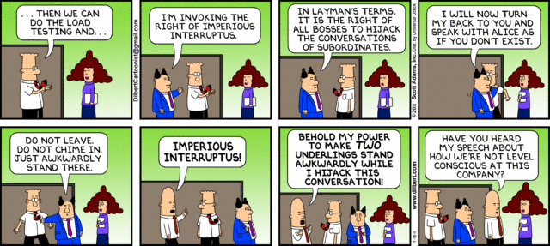
CST 347 – Real-Time OS

Slide 3
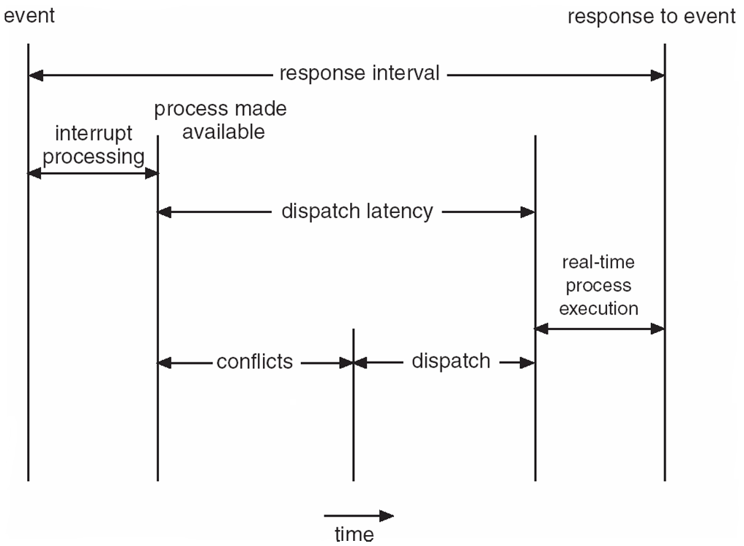
Interrupt Considerations
Notes:
Event – Button Push, Network Activity, Watchdog timer expired, etc.

Slide 4
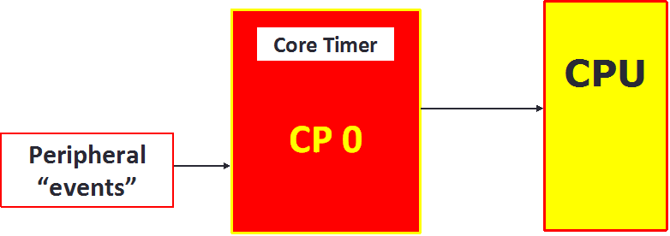
Interrupt Considerations

Slide 5
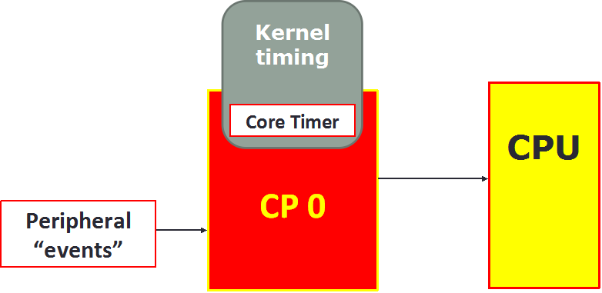
Interrupt Considerations

Slide 6
Interrupt Interactions
Core Timer used for kernel timing
  Highest priority interrupt in the PIC32 (MIPS) architecture
Other peripheral interrupts
  ISRs sit “outside” of any task
  When ISR running, tasks are not running
  Interact with tasks but do not treat like a task

Slide 7
Interrupt Interactions
ISRs should deal with the event only
FreeRTOS API calls allowed from ISR

Slide 8
Interrupts in FreeRTOS
Events
  Embedded real-time systems have to take actions in response to events that originate from the environment. For example, a packet arriving on an Ethernet peripheral (the event) might require passing to a TCP/IP stack for processing (the action). Non-trivial systems will have to service events that originate from multiple sources, all of which will have different processing overhead and response time requirements. In each case, a judgment has to be made as to the best event processing implementation strategy:
    How should the event be detected? Interrupts are normally used, but inputs can also be polled.
    When interrupts are used, how much processing should be performed inside the interrupt service routine (ISR), and how much outside? It is normally desirable to keep each ISR as short as possible.
    How can events be communicated to the main (non-ISR) code, and how can this code be structured to best accommodate processing of potentially asynchronous occurrences?
  FreeRTOS does not impose any specific event processing strategy on the application designer, but does provide features that allow the chosen strategy to be implemented in a simple and maintainable way.
  Note that only API functions and macros ending in ‘FromISR’ or ‘FROM_ISR’ should be used within an interrupt service routine.

Slide 9
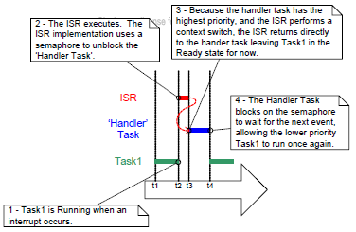
Deferred Interrupt Processing
Notes:
Uses semaphores

Slide 10
Writing FreeRTOS Interrupt Handlers
An ISR can be written entirely in C and exactly as described in the compiler documentation (with no special consideration being given to FreeRTOS) provided:
  The ISR does not cause a task to change state; for example, the ISR does not cause a task to leave the Blocked state or the Suspended state.
  The ISR itself cannot be interrupted.
In all other cases, the ISR must be entered through an assembly file wrapper

Slide 11
Writing FreeRTOS Interrupt Handlers
Writing the wrapper is simple as each one uses exactly this format, and FreeRTOS provides the portSAVE_CONTEXT() and portRESTORE_CONTEXT() macros in the ISR_Support.h header file.
The entire ISR could be written in assembler;
  however, it is more usual (and easier) to use the wrapper function to simply call a standard C function.

Slide 12
Writing FreeRTOS Interrupt Handlers
/* The name of the wrapper function. Replace vISR_Assembly_Wrapper with a more meaningful name, for example vUART0_ISR_Wrapper. */
vISR_Assembly_Wrapper:
/* Must be called first. */
portSAVE_CONTEXT
/* Call a C function to perform the real processing. Replace vISR_Function with a more meaningful name, for example vUART0_ISR_Handler. */
jal vISR_Function
nop
/* Must be called last. */
portRESTORE_CONTEXT
.end vISR_Assembly_Wrapper

Slide 13
Writing FreeRTOS Interrupt Handlers
An ISR is installed in the vector table using the compiler provided
  ‘__attribute__’ language extension.
Note that, because the assembly wrapper is used, the IPL value has no effect. The actual interrupt priority level used is set by calling the relevant PIC32 peripheral library function.
/* The following line should be included in a C file to install
vISR_Assembly_Wrapper() as the interrupt entry point for the
interrupt vector defined by _UART2_VECTOR. Note that, because the
FreeRTOS assembly wrapper macros are used, the IPL setting in the
following line of code has no effect. The interrupt priority would
be set using a PIC32 peripheral library call – which in the UART2
case would be a call to ConfigIntUART2(). */
void __attribute__((interrupt(ipl1), vector(_UART2_VECTOR))) vISR_Assembly_Wrapper( void );

